Slide 1
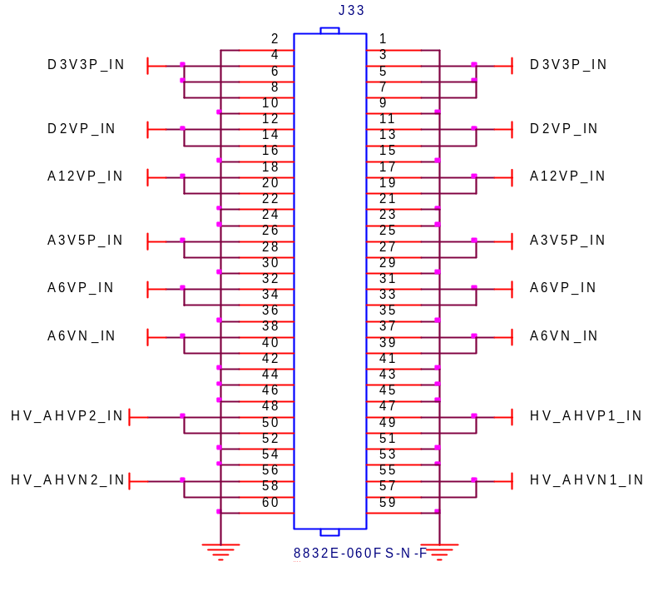
LTM4634EV
Triple
3.3VP@5A
2VP@5A
6VP@4A
5VP
LTM4634EV
Triple
3.5VP@5A
5VP@5A
PSOC
Power Control/ I2C/ Voltage Monitoring
6VN@4A
LTM4622A
Single
12VP@4A

